Slide 1

WELCOME TO
PARENT UNIVERSITY

Slide 2

LIVE INSTRUCTION DAILY!
LIVE INSTRUCTION DAILY!
Every class period
GRADES COUNT!
Notes:
Cotton speak to Support Staff assistance with making calls.

Slide 3
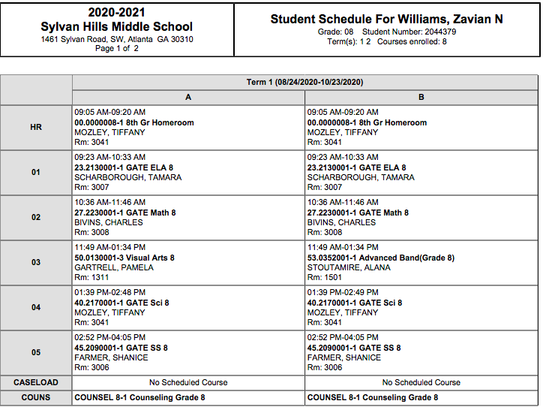
SAMPLE SCHEDULE
Notes:
IC access will inform your scholar’s specific schedule

Slide 4
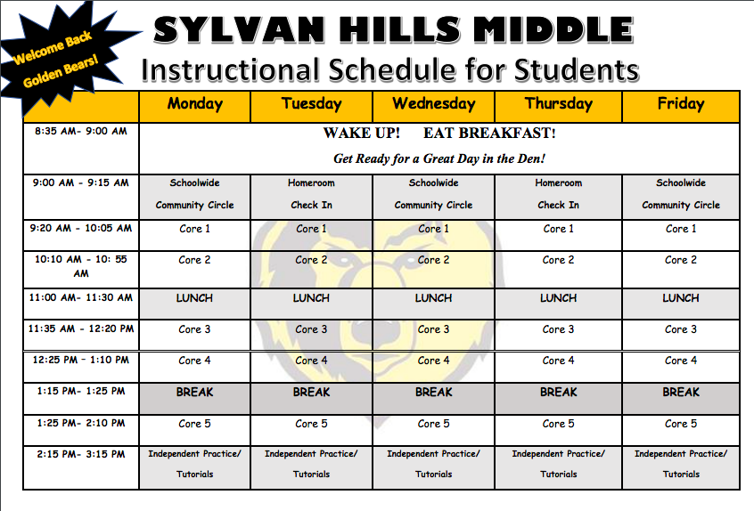
Notes:
Be sure to mention A/B Day

Slide 5
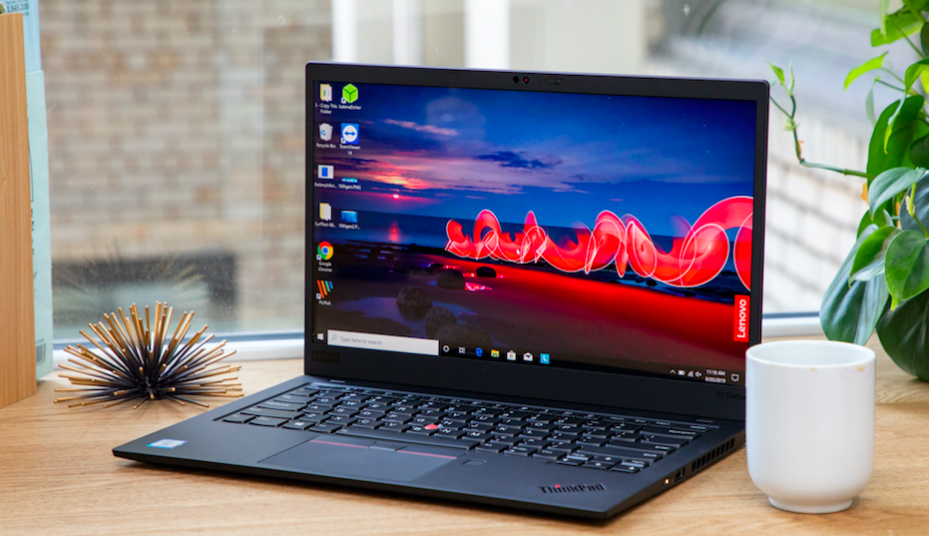
Technology
Need a Device?
Call the school to set up an appointment time for pick-up
Notes:
Owens insert technology

Slide 6


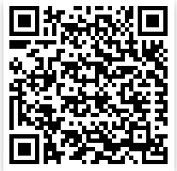
Atlanta Public Schools will be providing lunches for students.
Order meals through this site
Orders need to be placed by 11:59PM on Mondays

Slide 7
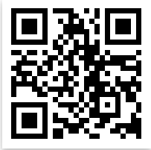
Parent Portal:
Access Student Schedules and Grades
Create, Reset, or Log in
https://www.atlantapublicschools.us/Page/48412
Quick-sheets are available on Sylvan’s Website.

Slide 8
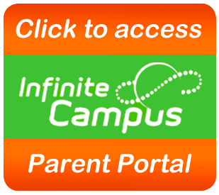
If You’ve Got Questions…
We’ve Got Answers!
What is Parent Portal? How do I register?
What information can I obtain from Parent Portal?
How do I access it? How do I access it?
I forgot my Username and Password.

Slide 9
Parent Portal
View Student Schedule
Access Student Grades
Monitor Attendance
Update Contact Information
School & District Notifications

Slide 10

Creating, Resetting, and Activating your Account
Download the App!
https://www.atlantapublicschools.us/Page/48412
Notes:
Show parents how to Navigate the site live

Slide 11
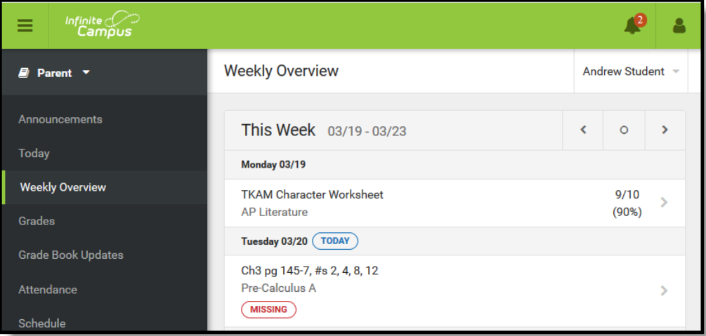
Home Screen Landing Page
Notes:
In the Campus Parent Portal, navigate between tools in the menu on the left. On mobile devices, this menu shrinks to a "hamburger" or "three bars" icon to save space.
Click the user icon in the top right to view Notification Settings.

Slide 12
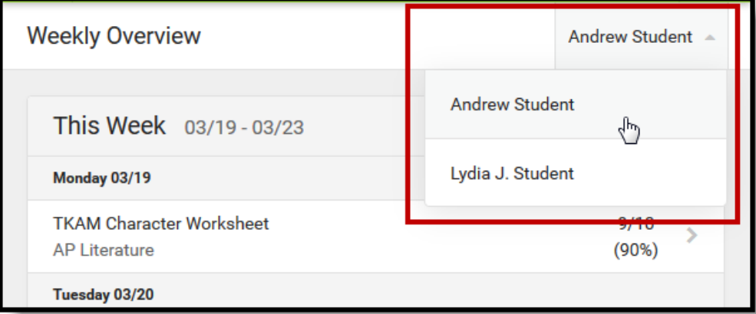
What if I have multiple students?
Notes:
If a tool is specific to a single student, such as Grades or Schedule, a student dropdown list displays in the top right corner. This dropdown list does not display for tools that are not student specific.

Slide 13
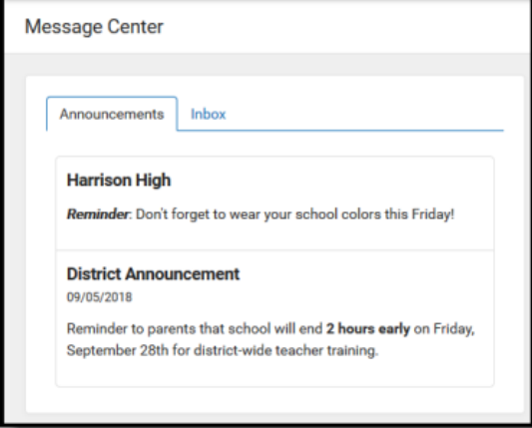
Parent Portal Tools
Message Center
The Message Center includes announcements are posted at a school or district level.
Click Show More to display additional text for longer announcements.
Additionally, the Inbox displays messages sent to the parent, including those from teachers.

Slide 14
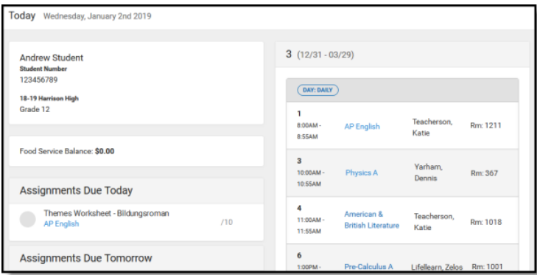
Parent Portal Tools
Today
The Today view shows the selected student's schedule for the current day and lists any assignments due today or tomorrow.
The schedule shows the times of the periods during the day and the student's courses, with the teacher's
name and room assigned.
The assignments list covers all of the student's courses, including those that may not meet on the current day. Click on the assignment or the coursename to view details.

Slide 15
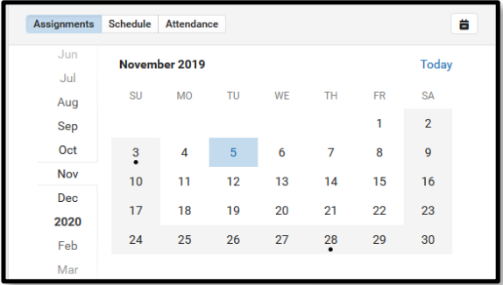
Parent Portal Tools
Calendar
The Calendar allows the selected student’s assignments, schedule, and attendance to be viewed at a glance.
Click the calendar dates to see each day at a glance. Use the Assignments, Schedule, and Attendance buttons at the top to view

Slide 16
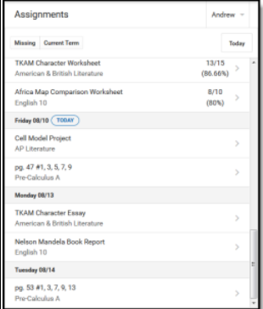
Parent Portal Tools
Assignments
The Assignments tool collects all of a student's assignments with the focus on today. Click assignments to view details and scroll to see previous and future assignments.
Use the Missing and Current Term buttons at the top to filter assignments.

Slide 17
Parent Portal Tools
Grades
The Grades tool shows all of the grades earned by the selected student for all tasks.
Posted grades are displayed in bold, with In-Progress grades indicated as "In-progress.“
Where the grey arrow displays for a task, click the task to view the Categories that contribute to the grade. Expand categories to view all included assignments. Click assignments to view details.

Slide 18
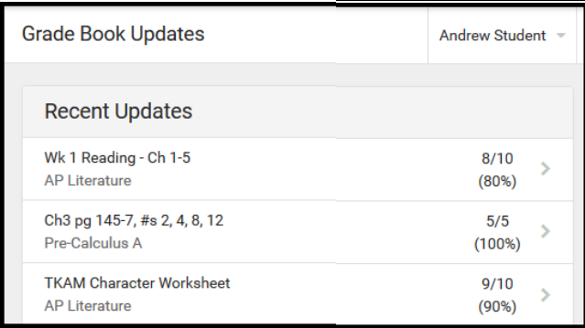
Parent Portal Tools
Grade Book Updates
Grade Book Updates lists all of the assignments that have been scored or otherwise updated in the last 14 days.
Click on the assignment or the course name to view details

Slide 19
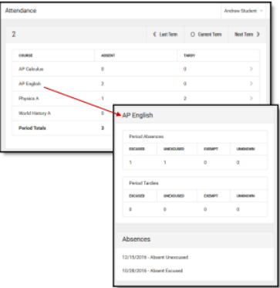
Parent Portal Tools
Attendance
The Attendance tool lists the absences and tardies for attendance taking periods in the selected term.
Click on a period to view details. On the detail view, absences and tardies are divided by type (excused, unexcused, exempt, or unknown), with all absences and tardies listed below.

Slide 20
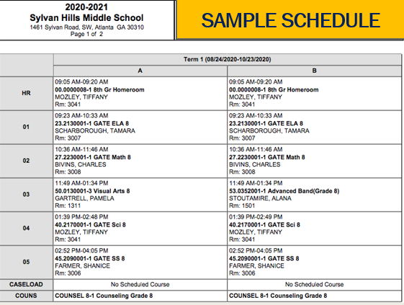
Parent Portal Tools
Schedule
The Schedule tool shows the student's schedule for each term, including any day rotations.
Each schedule includes the times of the periods during the day and the student's courses, with the teacher's name and room assigned.
****We are NOT using the times in IC, please refer to the Virtual Instructional Schedule****
Notes:
Please make sure you student knows their A Day and B Day schedule

Slide 21


Slide 22
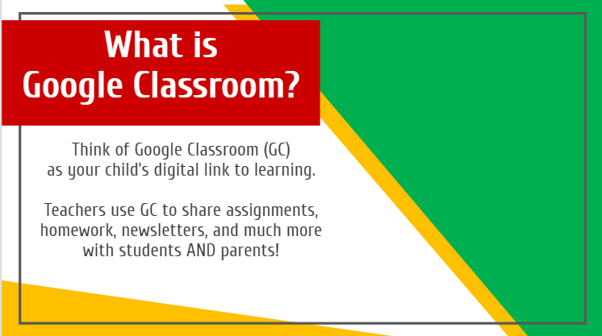
Think of Google Classroom (GC)
as your child’s digital link to learning.
Teachers use GC to share assignments, homework, newsletters, and much more with students AND parents!

Slide 23
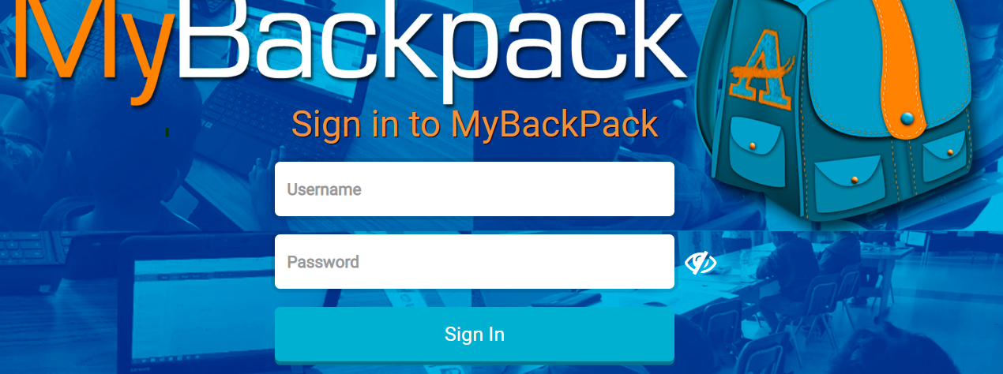
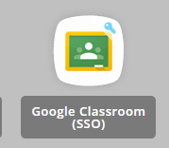
Students MUST log in to their ApsMybackpack using their Network ID and Password (Lunch #)
Click on the Google Classroom Icon
Notes:
The student will not be able to log in if there is another Google Account signed in on the same device.

Slide 24
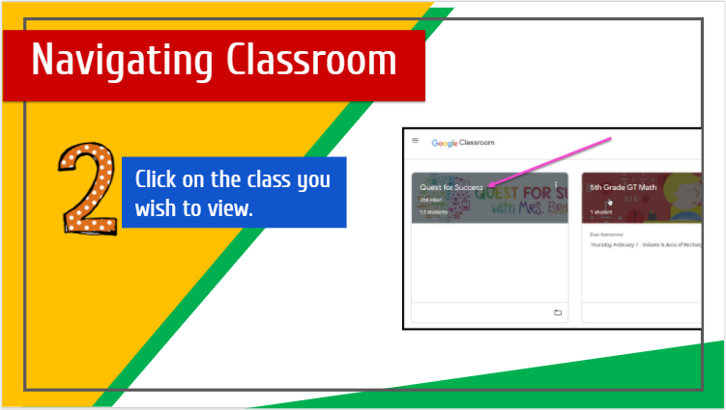

Slide 25
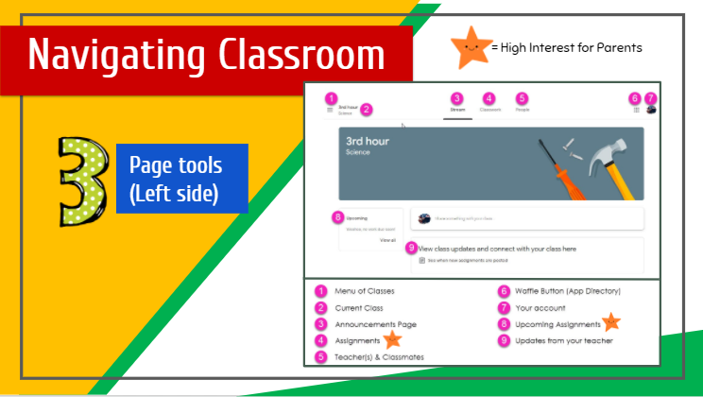

Slide 26
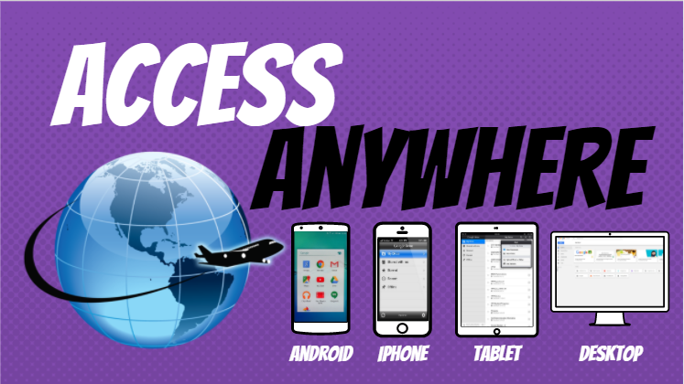

Slide 27
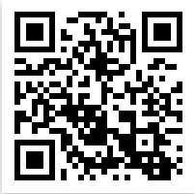


Connect with US!
@apssylvanhillsms
https://www.atlantapublicschools.us/Page/4020
@apssylvanhills
Notes:
The website is where you can find contact information for the Assistant Principals as well as the Counselors if you need assistance with anything.

Slide 28

SAVE THE DATE!
SHMS
Save the Date:
Wednesday, SEP. 2ND
At 5:30pm

